Slide 1



Remote Containers

Slide 2
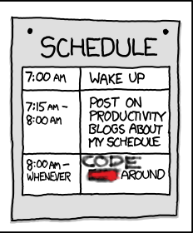
Objective: Procrastinate Furiously write code

Slide 3
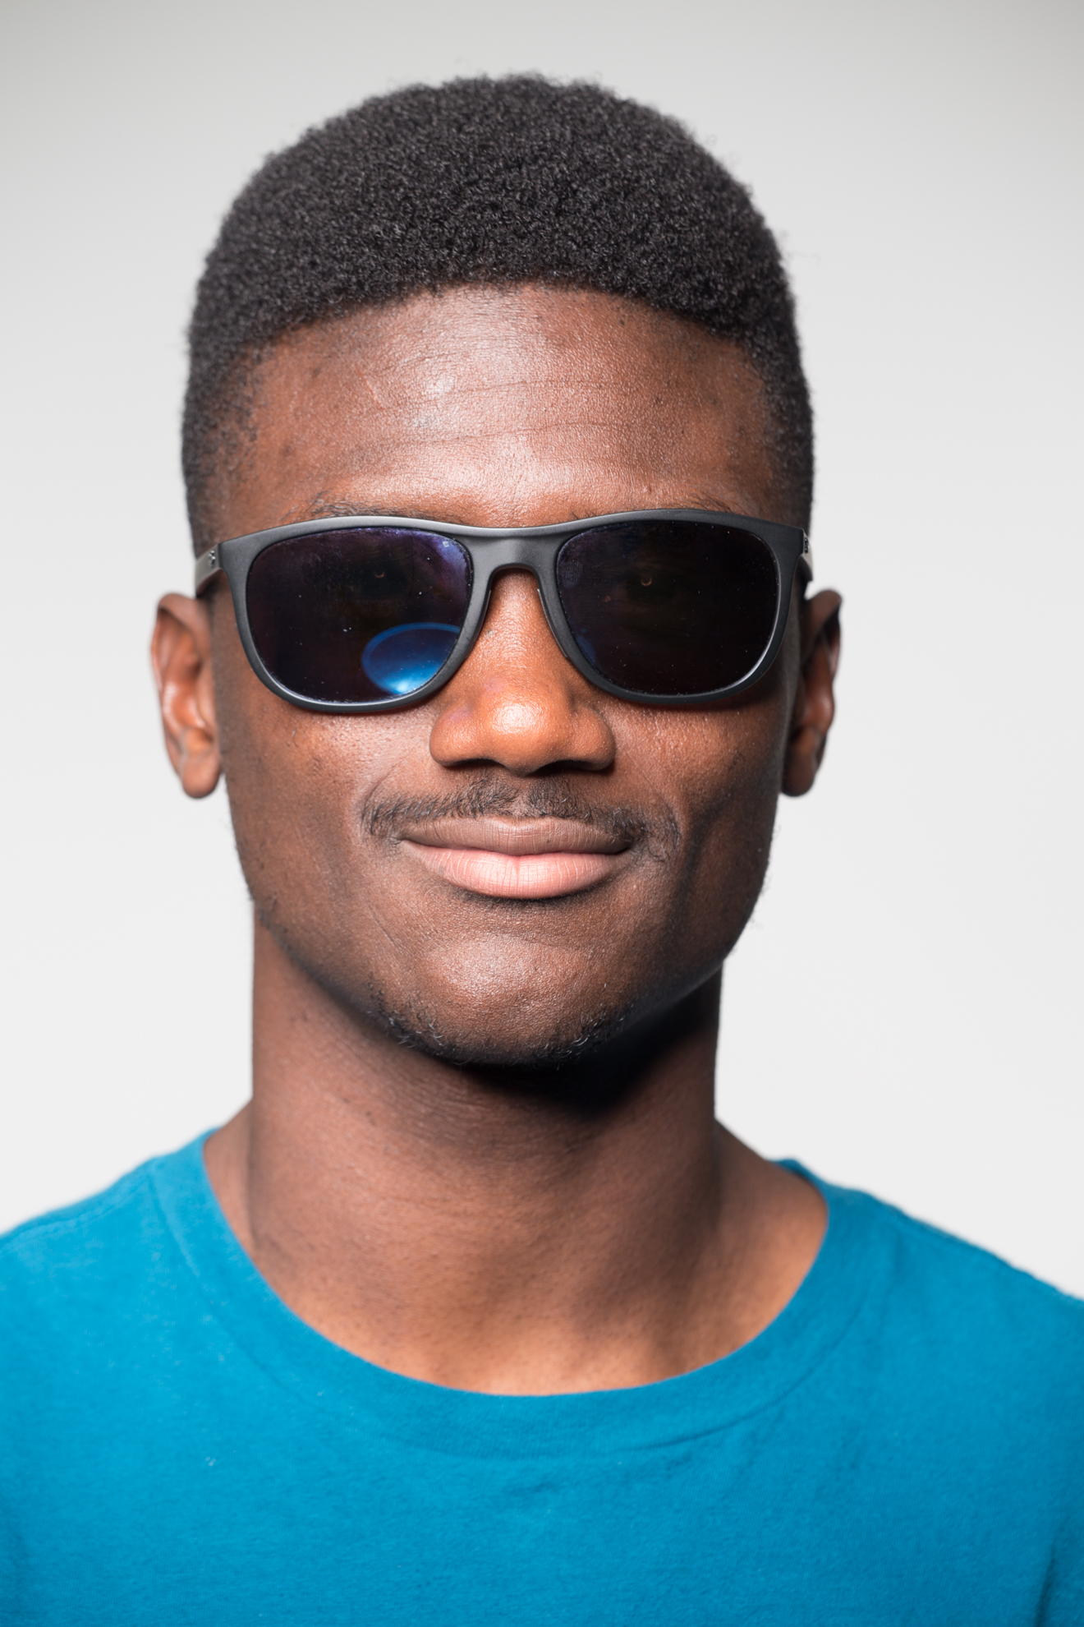
Obstacle: Someone joins the Platform team

Slide 4
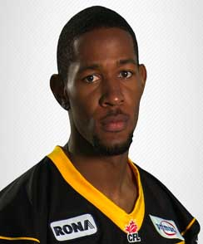
Boss comes over and says…
Manny’s going to need some help.
You cool?
- Boss

Slide 5
On-boarding at Healthwise (Day 3/5)
After finally receiving your machine and credentials…
Install Node (make sure is LTS)
Install Visual Studio Code
Download the repo from BitBucket
Run npm install.
Ask Marcus why it gets you buncha errors
Someone forgot to add configuration to the repo
Add it and go ahead and create your first Pull Request
Install VS React extension
Install ESLint extension
Ask Nate how to enable hot reload.
Keep getting errors? It works on my machine, you are on your own
…

Slide 6

Two days later, boss comes over again…
Hey so, is there any way you can document.
the process and standardize the tools?
- Boss

Slide 7
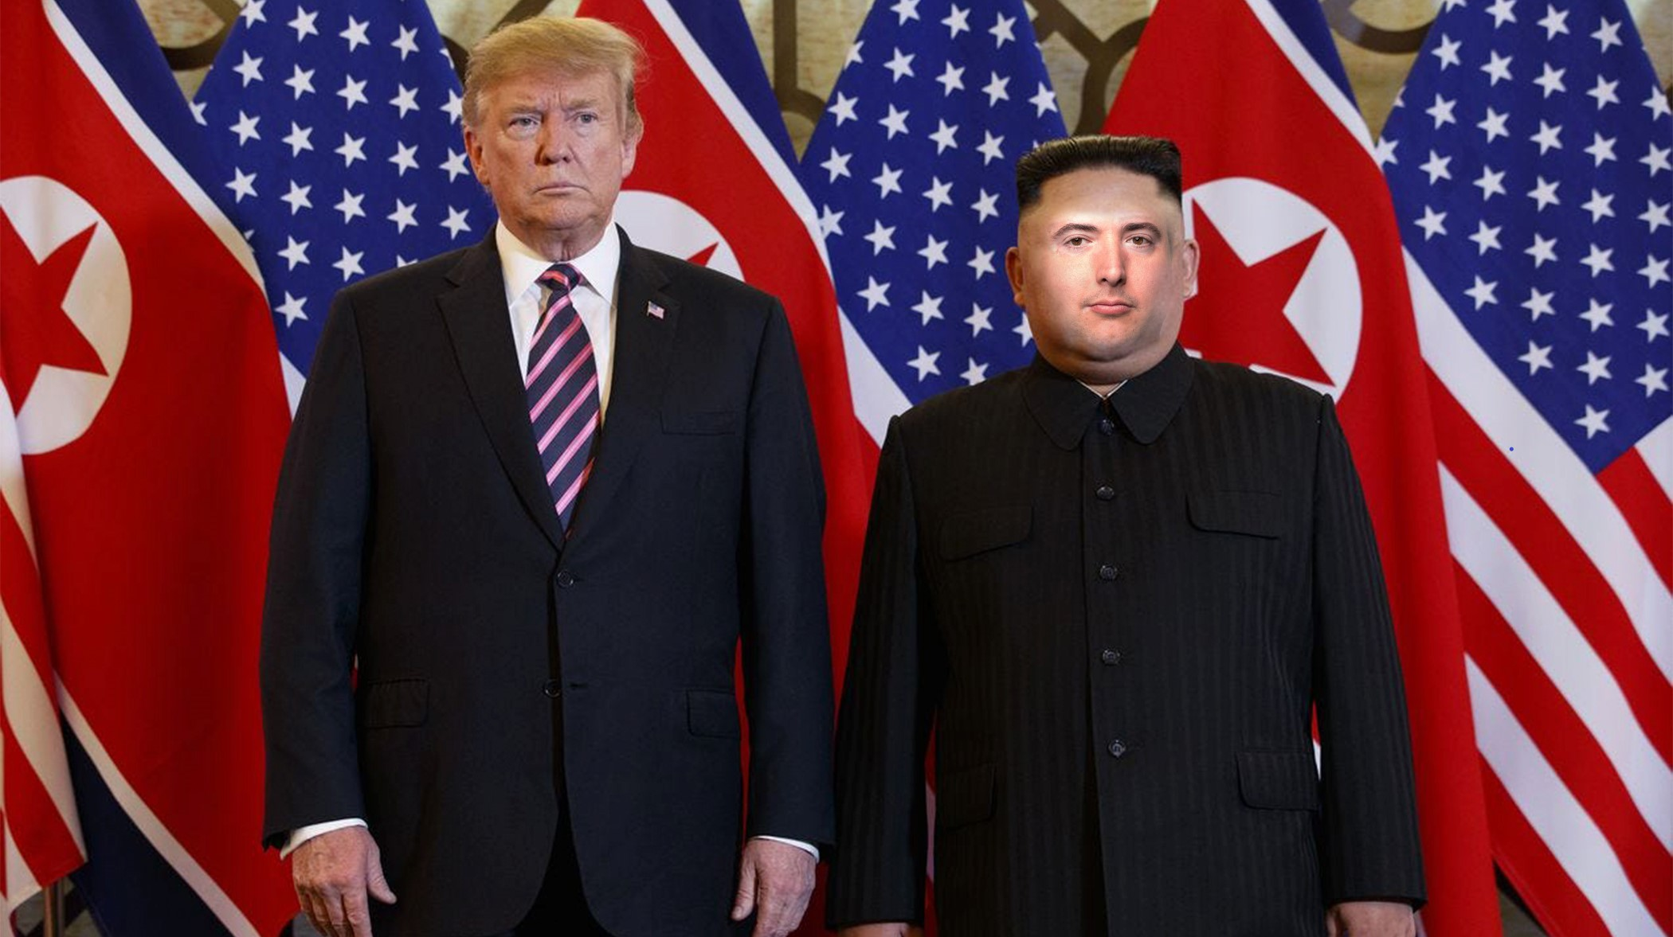
Everyone using the same tools!? SAD! A disgrace!
Oh, absolutely!

Slide 8
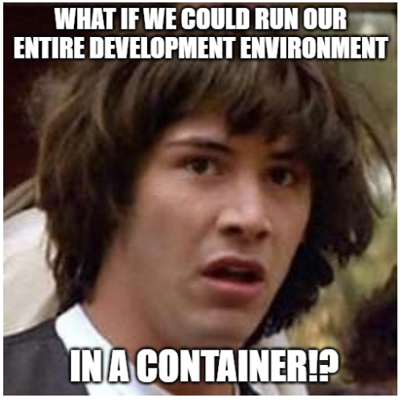

Slide 9
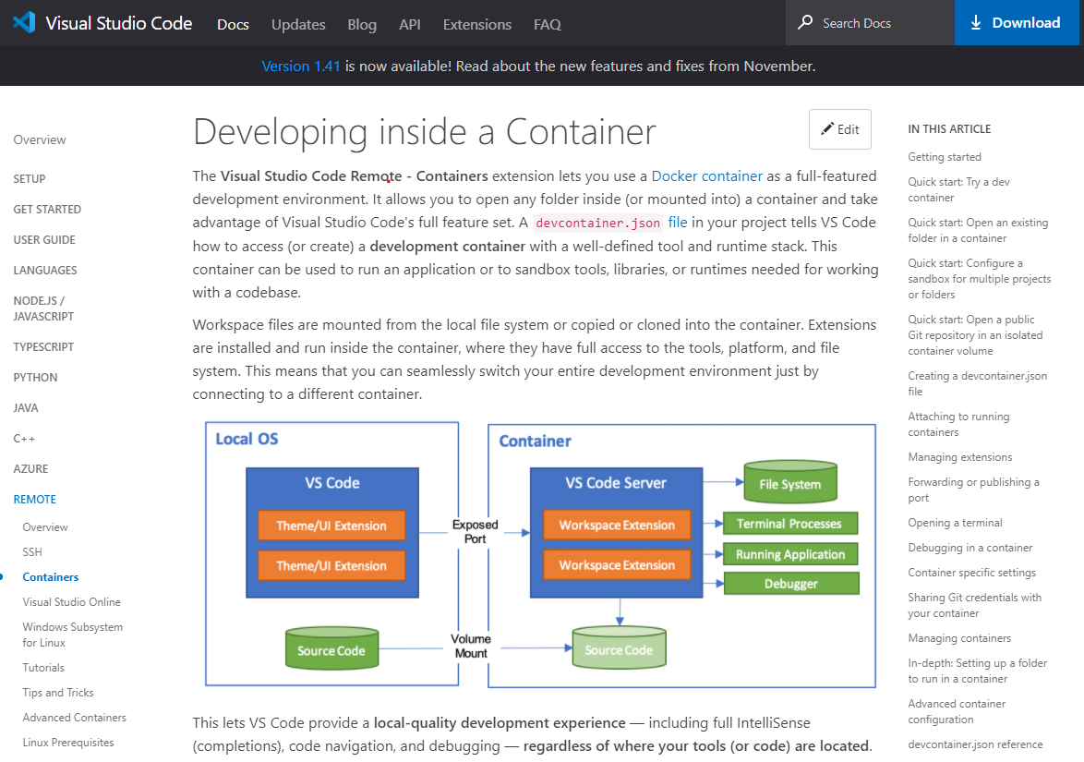

Slide 10


